Slide 1
MACHINE LEARNING FOR CLINICAL CARE AND RESEARCH AT INTERMOUNTAIN
You can predict the future.
So what?
Moving from accurate predictions to rigorous, patient-centered treatment decisions
Brian Locke, MD, MSCI | Pulmonary & Critical Care Grand Rounds | Intermountain Medical Center
June 2, 2026
Disclosure: Relevant financial relationship. Equity in Mountain Biometrics (MTN), non-clinical AI startup related to data harmonization.
Notes:
Raw Transcript from my delivery:
IMC-01-AUD-WEST
0 minutes 3 seconds0:03
IMC-01-AUD-WEST 0 minutes 3 seconds
It's an all-day conference. You can register for virtual or in-person attendance through IPCE. Second announcement is that Angiotensin II was approved for pediatrics and adults by the Intermountain IRB, or not IRB,
IMC-01-AUD-WEST 0 minutes 23 seconds
PNT with restrictions. And those main restrictions are norepinephrine plus greater than or equal to 0.4 micrograms per kilogram per minute of norepinephrine equivalent vasopressors. And then adequate volume resuscitation. There's a number of ways to meet that.
IMC-01-AUD-WEST 0 minutes 44 seconds
consideration for using methylene blue or hydroxycobalamin prior to initiating angiotensin 2, and then requirement for a central line, and then stopping it if it doesn't seem to be helping. So I don't know when drug will be available.
IMC-01-AUD-WEST 1 minute 4 seconds
been working with Sophie Entinger, one of the PharmDs who did all the research and we presented it together at PNT. So I'll ask her when it'll be available, but it's been approved. And there's a document, Chris, that I asked her just to be the key
IMC-01-AUD-WEST 1 minute 24 seconds
She put it in SharePoint and there's a link and I'll send you the link and we can put it on the critical care website. Is that the best place to put it? Okay.
IMC-01-AUD-WEST 1 minute 34 seconds
All right, so not today, but I assume it'll take time for hospitals to order it and get it in. And the restrictions are there because it's pretty expensive. And if it doesn't work, though, the company has said that you can return the open vial to them.
IMC-01-AUD-WEST 1 minute 55 seconds
stop it, return the open vial to them, and they'll give us another vial. So I don't know if anybody's taken them up on that. All right, it's my pleasure to introduce Dr. Brian Locke. He's one of our academic pulmonary and critical care physicians at the assistant professor level. And
IMC-01-AUD-WEST 2 minutes 14 seconds
He's going to talk to us today about machine learning for clinical care and research at IntermountainHealth.
IMC-01-AUD-WEST 2 minutes 20 seconds
Welcome.
IMC-01-AUD-WEST 2 minutes 24 seconds
Great. Yeah, thanks everyone for the opportunity. So broad topic, but I'll just hop right in to make sure we get time to cover everything. So the rationale for why I wanted to talk about this. So for those that don't know, I'm a computer science trained in North Biz software.
IMC-01-AUD-WEST 46 minutes 59 seconds
And so we need ways to try to be more efficient with our trials, to try to get it, you know, can we design this in a way that if there's even smaller effects that we can detect them? And I think one of the ways that has gotten a lot of attention, I think rightfully so, is, you know, maybe we can use other endpoints that are a bit more informative.
IMC-01-AUD-WEST 47 minutes 20 seconds
things like ventilator-free days or modeling the trajectory out through time. Some of the other ways that folks can do this is to, you know, enrich through predictive modeling, as we talked about, or to borrow Sam's analogy of signal versus noise is to try to do things
IMC-01-AUD-WEST 47 minutes 42 seconds
that reduce the amount of noise in the population. And so that might be enrolling a homogeneous population, or as I'll talk about now, actually using a predictive model is one way to control out noise. And so this is in contrast to what we were doing before, where we were using predictive modeling to enrich who we enroll.
IMC-01-AUD-WEST 48 minutes 3 seconds
After randomization, if you include a prediction score in your model of how you calculate your primary outcome, so you're essentially taking one component of noise out of the background. And so to explain that in a little bit less mathy and more intuitive way,
IMC-01-AUD-WEST 48 minutes 22 seconds
You know, if we can think about when we are trying to isolate background noise in a trial, the result that each patient sees is going to be dependent, some on which treatment arm they're in, some on their baseline risk, and then some on their residual, you know, everything else, random chance.
IMC-01-AUD-WEST 48 minutes 42 seconds
And that if we have a good prediction model to account for that baseline risk, that reduces 1 component of variation for why a patient might have the outcome that they had. And that if you take that component out, there's less left over, and so it's easier to identify the treatment effect.
IMC-01-AUD-WEST 49 minutes 3 seconds
And so you actually can get quite large gains in efficiency if you do this when it's available. And so one way to sort of estimate how or quantify how good a prediction model is, is in terms of how much of the variance in the outcome does the risk model
IMC-01-AUD-WEST 49 minutes 23 seconds
explain. And so, you know, you can imagine a perfect risk model would explain all the variation in the outcome, meaning if, going back to our initial Ascend MA trial, if the prediction model perfectly predicted how much healthcare utilization each patient was going to have,
IMC-01-AUD-WEST 49 minutes 42 seconds
you know, then a prediction being a little bit higher would lead to a little bit, would correspond to a little bit more healthcare expenditure and vice versa. And in that case, the only, if you had perfect foresight, then the only difference in outcomes that you would see in the trial would be from the intervention. You know, granted, nobody's prediction models are that good and were often used
IMC-01-AUD-WEST 50 minutes 3 seconds
using models that are somewhere in the like 0.2 of the variation explained, but that that can still increase the efficiency of your trial by, you know, 25% or so. And so this is the power calculation from the trial that we talked about earlier, which is to say, depending on exactly how good that prediction model is, when we then go to analyze the
IMC-01-AUD-WEST 50 minutes 24 seconds
outcomes, we may be able to get significantly more power from our trial, meaning a more effective estimate and more ability to detect smaller changes in cost outcomes. And that, you know, I think trial guidance has generally gone to recommending that whenever
IMC-01-AUD-WEST 50 minutes 44 seconds
good prognostic information is available, whether it's a model or other things that aren't per se like in a model, but we know strongly correspond to the outcome, is to include those in your trial to analyze your outcome. And that the converse of this goes with how we apply the results. And so
IMC-01-AUD-WEST 51 minutes 5 seconds
This is going to be the last point that I'll leave us with, which is to say, you know, we're encouraged, I think correctly so, to think of trial results in terms of, you know, the absolute risk reduction, or the other way to summarize that is the reciprocal of it, which is the number needed to treat. You know, how many people would need to receive this intervention to change
IMC-01-AUD-WEST 51 minutes 25 seconds
one of the outcome, you know, in the case of mortality, how many folks would you need to treat to save one life? And, you know, this is a average for the patients that are enrolled in the sample. And so you can imagine that not everybody in the trial is going to have similar risk. And so if it's a
IMC-01-AUD-WEST 51 minutes 46 seconds
you know, ARDS trial and risk of death is, or death is the outcome, some patients are at much higher risk than others of receiving the outcome or experiencing the outcome, and that when you present an absolute risk reduction, you're averaging it over that sample. And so
IMC-01-AUD-WEST 52 minutes 5 seconds
There's A variety of sources of data that have empirically borne this out, which is to say, you're going to be overestimating the benefit in folks that are low risk and underestimating the benefit in folks that are high risk if you use that average. And that if we account for that risk modeling when we counsel patients,
IMC-01-AUD-WEST 52 minutes 25 seconds
will be able to get more targeted estimates of how much an individual will benefit. And I'll say, this is actually a paradigm that's becoming more and more frequently used in guidelines. And so, for example, in 2024, the SCCM released new stress ulcer prophylaxis guidelines.
IMC-01-AUD-WEST 52 minutes 46 seconds
And in those guidelines, they say, so there's a variety of trials, they're primarily in intubated patients. And so the traditional teaching was always, if you're intubated, stress ulcer prophylaxis is indicated. The approach that the 2024 guidelines say is, you know, we've estimated the relative risk reduction, meaning
IMC-01-AUD-WEST 53 minutes 6 seconds
In relative terms, how effective do we think stress ulcer prophylaxis is for preventing GI bleeds? And then we have good predictive models that tell us which factors are independently associated with a higher risk of bleeding. And that the leap of logic that the 2024
IMC-01-AUD-WEST 53 minutes 25 seconds
stress ulcer guidelines say is to say if you have a risk factor that increases your risk of a GI bleed to the point where we expect that that relative risk reduction will translate into an important absolute risk reduction, that stress ulcer prophylaxis is indicated. And so importantly, the thing that's different about that is that it means that
IMC-01-AUD-WEST 53 minutes 47 seconds
even though some people who were intubated and included in some of these trials that showed benefit, the guidelines actually don't say if you're intubated but don't have these other risk factors that you actually should receive stress ulcer prophylaxis. And it's because of that extrapolation, which is to say
IMC-01-AUD-WEST 54 minutes 6 seconds
intubation alone only confers a smaller excess risk of bleed. And so, you know, that's the reasoning, I think, and it's built on a prediction model of how much risk folks have of stress ulcer prophylaxis. And I think that sort of reasoning pervades other specialties like cardiology.
IMC-01-AUD-WEST 54 minutes 27 seconds
quite a bit more because they have more data, but I think it's likely coming to pulmonary and critical care medicine in the near future. And so that takes me to the end of, I think, where I'll end just since we're at time. So I'm just going to end with this slide, which is to thank everybody that's been helping me put together these trials and the grant that will be going in soon. And I'll take any questions if people have one.

Slide 2
INTRODUCTION
Predictions are purportedly accurate
Clinical impact generally remains … disappointing?
THE PROMISE
THE REALITY
Impressive prediction.
Few are as accurate as claimed.
Few models can be used at bedside.
Few change decisions.
?
Notes:
Purpose: Anti-hype slide that separates model performance from clinical impact.
Key line: AUC is upstream of the endpoint we actually care about.
Transition: Now name the hard question.
Source anchors: A Few Good Metrics; STRATOS TG6 / Van Calster et al.
Can you recenter the AUC curve in the box?

Slide 3
CME QUESTION | RISK MODELS
A properly used risk model can improve an RCT by:
Select the best answer
Enriching the population of interest, thereby making the trial more efficient
Allowing more efficient estimation of the treatment-effect size
A
B
Enabling more personalized application of treatment-effect estimates to individual patients
All of the above
C
D

Slide 4
CME QUESTION | RISK MODELS
A properly used risk model can improve an RCT by:
Select the best answer
Enriching the population of interest, thereby making the trial more efficient
Allowing more efficient estimation of the treatment-effect size
A
B
Enabling more personalized application of treatment-effect estimates to individual patients
All of the above
C
D
Risk prediction can support trial design, effect estimation, and patient-level interpretation.

Slide 5

INTRODUCTION
You can predict the future. So what?
Prediction
Purpose
Action
Impact
risk, class, outcome
→
the bottleneck
→
change a decision
→
better care / research
Notes:
Purpose: Establish the organizing question for the whole talk.
Key line: The hard question is not whether a model predicts; it is what the prediction is for.
Transition: Introduce the four answers, but keep this slide focused on purpose.
Source anchors: Current deck opening; rebuild ticket.

Slide 6
ROADMAP
Four ways to make use of good predictions
ACT
ENRICH
Clinical decision support: act when expected benefit exceeds burden
Run trials in the patients who may benefit most
ESTIMATE
PERSONALIZE
Reduce noise: remove predictable variation, preserve randomization
Risk-targeting: tailor by each patient’s baseline risk
Notes:
Purpose: Present the only taxonomy used in the deck.
Key line: Prediction earns its keep when it does one of four jobs: act, label, enrich, or estimate.
Transition: Start with Act using the Wells Score.
Source anchors: Rebuild ticket; current taxonomy slide.

Slide 7
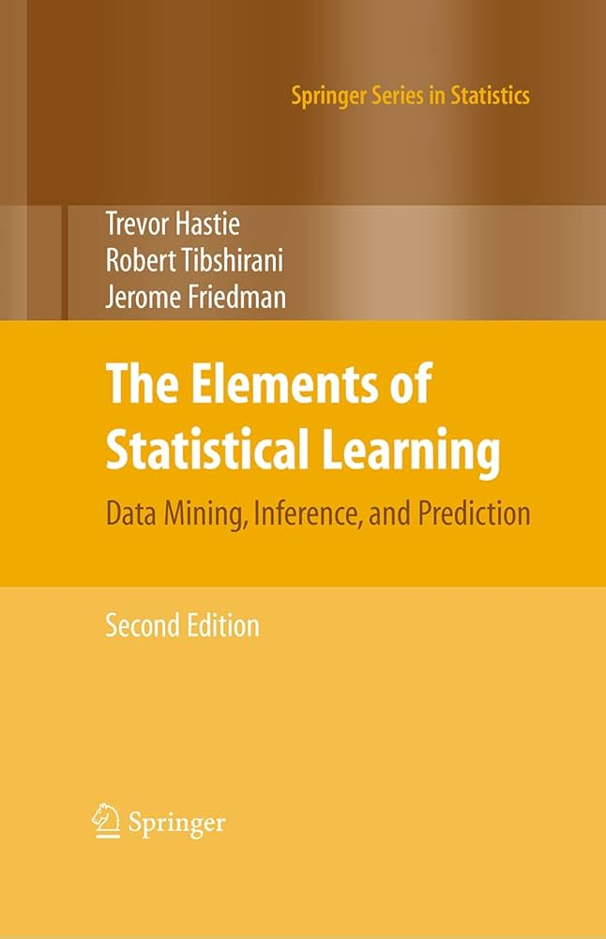
ACT | MACHINE LEARNING
ML finds the map from predictors to an outcome
Predictors
Algorithm
Output
age, vitals, labs
→
learns the mapping
→
classification or regression
Learn relationships in one set of observations, apply to new ones.
Notes:
Purpose: Bridge familiar clinical rules to machine learning without teaching model classes.
Key line: Machine learning is not synonymous with neural networks.
Transition: PE diagnosis created a narrow action problem.
Source anchors: View from the MTN ML article; Wells Score background.

Slide 8
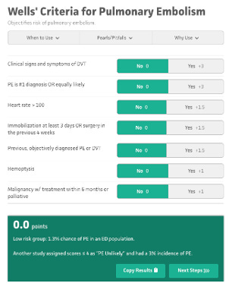
ACT | MACHINE LEARNING
Fit a best-fit line (in log-odds space) → probability
log-odds
rule-out
rule-in
P = 1
logit⁻¹
→
p = β₀ + β₁x₁ + β₂x₂
P = 0
linear predictor (η)
linear predictor (η)
No one does this math at the bedside… except you do.
Notes:
Purpose: Anchor Wells in a specific action, not diagnosis in the abstract.
Key line: The useful question was who can safely avoid CT.
Transition: Show how Wells became a workflow.
Source anchors: Wells Score background; current Wells section.

Slide 9
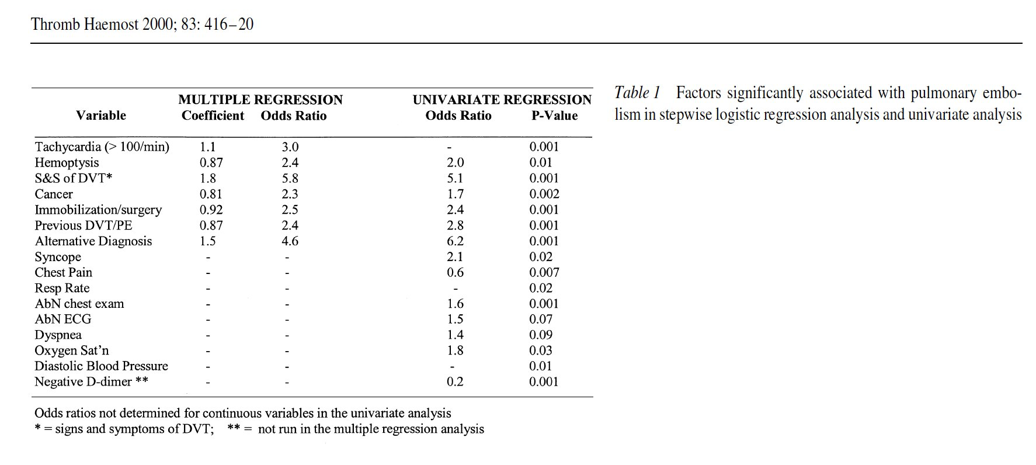
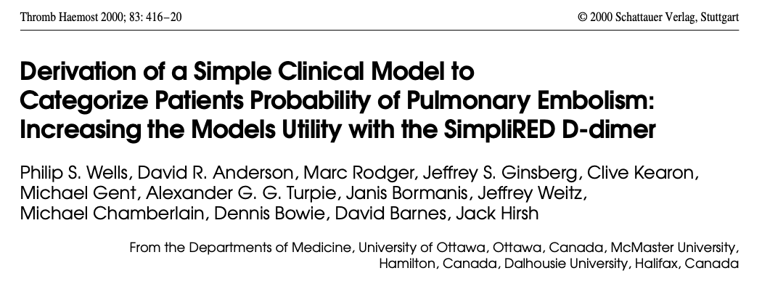
ACT | MACHINE LEARNING
Wells: regression coefficients → point score
Round the coefficients and pick points that line up with decision thresholds = score
Wells et al., Thromb Haemost 2000;83:416–20.
Notes:
Purpose: Compress Wells history into the development pathway that made it usable.
Key line: Wells worked because it became a validated workflow.
Transition: Reduce the mechanics to one logistic-regression slide.
Source anchors: Wells et al. 2000; View from the MTN Wells article.

Slide 10
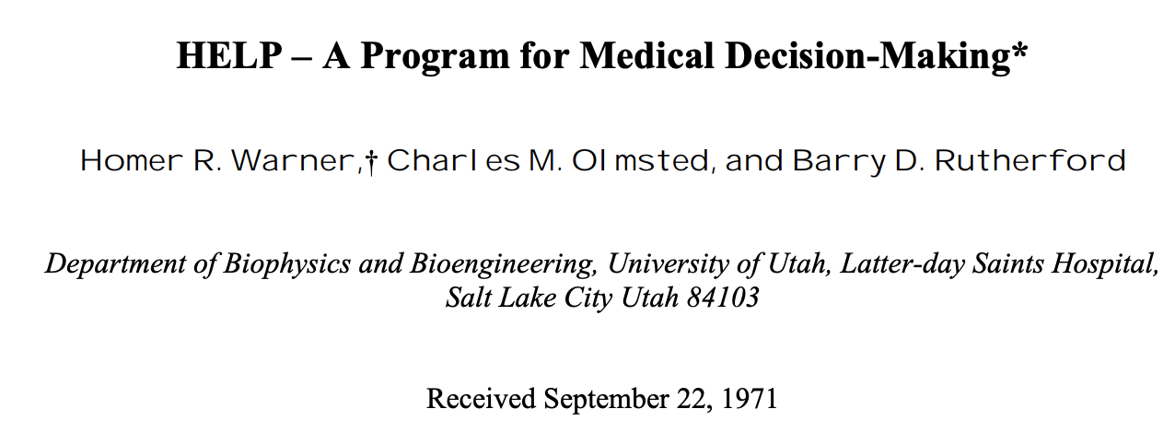
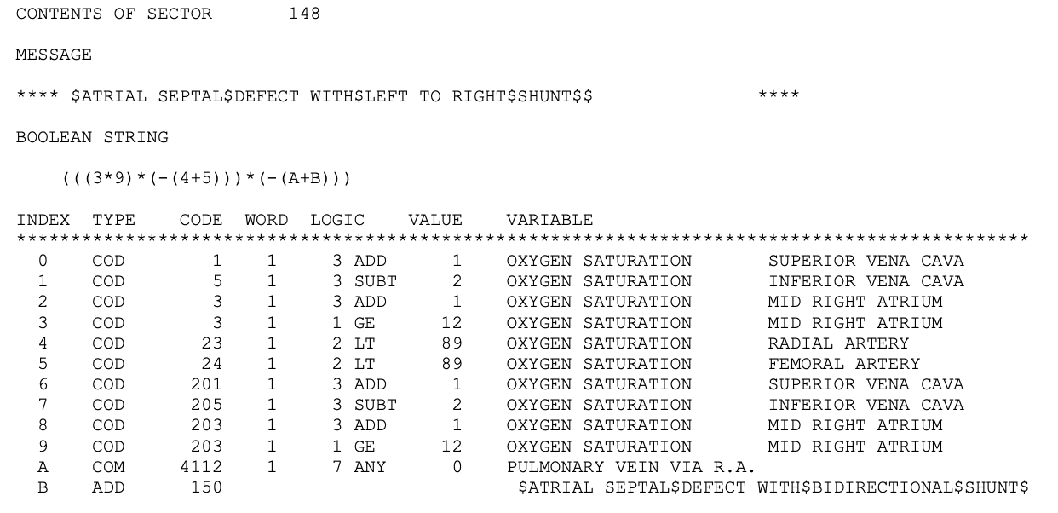
ACT | MACHINE LEARNING
Intermountain: bedside decision support in 1967
At LDS Hospital, HELP captured coded clinical data into a shared patient record, applied modular medical logic, and returned patient-specific diagnoses, alerts, reminders, and treatment recommendations.
Capturing data for machine learning was the original motivation for the EHR.
Notes:
HELP was not modern machine learning. It was earlier and arguably more operationally mature: a coded clinical database plus executable medical knowledge. It used deterministic if-then logic, Bayesian probability calculations, temporal rules, monitoring logic, and explanations to support real decisions in cardiology, ICU care, radiology, pharmacy, laboratory interpretation, infection surveillance, and antibiotic management.

Slide 11
CLINICAL PREDICTION MODELS
Statistical learning is embedded in routine care
Clinical tools convert observed features into estimates, categories, or action thresholds.
Wells score
eGFR
Apgar
Framingham risk
Findings + history
→ weighted rule
→ probability estimate
Creatinine + demographics
→ regression model
→ kidney estimate
Observed signs
→ composite score
→ transition status
Risk factors + labels
→ cohort model
→ treatment threshold
Notes:
Purpose: Introduce the reference-class problem.
Key line: A diagnosis is useful if the class helps predict prognosis, mechanism, treatment response, or routing.
Transition: Define fitness for purpose.
Source anchors: Current reference-class section; K23 framing memory.

Slide 12
RECAP
Machine learning for clinical decisions
ML learns patterns
Good ML is embedded
It already has impact
Machine learning finds mapping from predictors to an output.
It quietly underlies much of usual practice
Though perhaps not as much as it could (should)
Machine Learning can be used for things other than clinical decision support.

Slide 13
PRAGMATIC NOSOLOGY
Prediction for Condition labels
Classification draws useful boundaries around physiology: pragmatic constructs
Explain the present
Make symptoms, signs, or abnormal findings cohere.
Predict the future
Estimate risk of clinically important outcomes.
Guide action
Identify who benefits enough to treat, monitor, or route.
Disease categories are tools, not natural kinds (usually).
Boundaries are drawn across continuous physiology when the grouping helps describe, predict, or guide action.
Stegenga 2018; Doust et al., JAMA Intern Med 2017; Ranieri et al., AJRCCM 2022; Carrell et al., JAMIA 2025
Notes:
Purpose: Reframe disease definitions as purposeful scientific and clinical tools. Key line: A disease definition is not simply a mirror of nature; it is a tool that must be judged against a job. Transition: Once the purpose is explicit, separate definitions based on present abnormality from those based on future risk. Source anchors: Stegenga; Doust et al.; Ranieri et al. AJRCCM 2022; Carrell et al. JAMIA 2025.

Slide 14
LABEL DESIGN
Cutpoints, risk thresholds serve different purposes
Use abnormality labels to describe observed state; use risk labels to justify action.
Abnormality label
Risk / action label
How far from a reference state?
When is action worth taking?
HLD
LDL-C above a cutpoint labels a lipid abnormality.
Ten-year ASCVD risk estimates likely benefit from statin treatment.
Lung nodule
Size and morphology label an imaging abnormality.
Estimated malignancy risk determines surveillance, PET, biopsy, or resection.
Notes:
Purpose: Contrast abnormality-based and risk-based disease definitions. Key line: Abnormality asks what is unusual now; risk asks what future harm is likely. Transition: Use hyperlipidemia as the familiar example of this shift. Source anchors: Stegenga; Aronowitz Risky Medicine; Doust et al. JAMA Internal Medicine 2017.

Slide 15
GUIDELINE CASE
2013 ACC/AHA: used risk prediction to make cholesterol labels action-oriented
LDL-C abnormality label
Statin-benefit action class
Classifies a measurement Work: description
Classifies expected benefit Work: treatment threshold
Sources: ATP III; 2013 ACC/AHA cholesterol guideline; Pooled Cohort Equations
Notes:
Purpose: Use cholesterol to show the shift from biomarker abnormality toward preventable event risk and expected benefit. Key line: The question moved from is the LDL high to is this patient's absolute ASCVD risk high enough that lipid lowering is worth it. Transition: This is not only philosophical; the screening math makes risk central to action. Source anchors: ATP III; 2013 ACC/AHA Blood Cholesterol Guideline; Pooled Cohort Equations.
Purpose of a HLD label is really just to indicate you should be on medications to improve your risk profile.

Slide 16
ACT | DECISIONS UNDER UNCERTAINTY
We act before we know the counterfactual
At decision time, only one outcome will ever be observed — the rest stay hidden.
THE DECISION
LIKE POKER
Path taken — outcome seen
You don’t control the cards — you control the bet.
Good decisions play the odds toward outcomes you can’t yet see.
Path not taken — never seen
We choose one action; the other futures never reveal their results.
Judge the decision by the odds it played, not only by the one outcome we happened to observe.
Decision quality vs. outcome; counterfactual framing.

Slide 17
ACT | RISK-BASED
Baseline risk is a ceiling on benefit
Calipers mark the only group that can possibly benefit
remaining patients would never have the outcome
~33
High risk
would get outcome
would never have outcome
~33%
~15
Medium risk
~15%
~5
Low risk
~5%
You can only prevent an outcome that was going to happen.
Kent 2023
Notes:
Purpose: Show why risk-based definitions are advantageous for guiding action by using screening math. Key line: Baseline risk is not background information; it determines predictive value, yield, and false-positive burden. Transition: This same logic motivates transition-care phenotypes: the useful HRF label should route scarce post-discharge attention. Source anchors: Bayes theorem; diagnostic threshold logic; screening PPV example.

Slide 18
ACT | RISK-BASED TREATMENT
Preventive care has cruel base-rate math
Before the outcome happens, most people cannot benefit; everyone touched can still be burdened.
Treatable few
Would not have event anyway
Event despite action
Burden scales with everyone touched
Benefit scales with the preventable few
outreach, testing, false positives, anxiety, tx burden
avoided admissions, events, or deaths
ARR = baseline risk x relative risk reduction; NNT = 1 / ARR
Earlier action lowers the base rate; benefit:harm math becomes unforgiving.
Sources: Welch & Passow, JAMA Intern Med 2014; Welch, Schwartz & Woloshin

Slide 19
CARE STRATEGY
Proactive care has two viable paths
Unless action nearly harmless, the population must be selected by expected benefit.
Intermountain priority: act before avoidable deterioration
1 Stay harmless
2 Target preventable risk
3 Failure mode
Deploy broadly only when actions are safe, cheap, and low-burden.
Use models when action carries cost, harm, or capacity burden.
Treating everyone lets harms and costs accumulate.
Action threshold: expected benefit > harm + cost + capacity burden
Modeling matters because proactive care is earlier care under uncertainty.

Slide 20
ACT I | USUAL CARE
Risk scores already route some patients into proactive care
Prediction
Triage
Navigator Help
Claims, utilization history, diagnoses, and demographics feed a Predictive Risk Model that flags high- or rising-risk members.
Members are routed to care coordination or management.
Care gaps, social determinants (SDoH), transitions, and escalation.
What this looks like operationally
Coordinators organize care, navigate benefits, and connect patients to preventive and social-needs support.
Notes:
Purpose: Make the clinical operations analogy concrete and professional on slide.
Key line: AI can expand the range of questions we can act on quickly and reasonably.
Transition: Then define the comparator as the available care system.
Source anchors: Current slide 30; ASCEND-MA framing.
Oral bridge: My girlfriend gives me a hard time when I use AI to do things I probably would have spent the time to think through myself. That critique is basically right: that can become cognitive outsourcing. The more useful pattern is different. AI lets me look into things I would otherwise shrug off because I lack the time, confidence, or activation energy to investigate them. It expands the sphere where I can act quickly and reasonably.
Pivot: That is the clinical operations analogy. The sickest patients are often already visible. AI may be most useful when it expands care-team attention into the rising-risk middle.

Slide 21
ASCEND-MA Trial
AI-Supported Care Engagement for Next-step Delivery
— Medicare Advantage
Study team: Joseph Kamerath, MD (PI); Brian Locke, MD; Haya Khalaf, RN;
Kate Minick, PhD; Samuel Brown, MD
Can prediction extend preventive attention to patients
not yet reached by usual care?
Notes:
Purpose: Show ASCEND-MA as implementation case study.
Key line: The outcome is not AUC; the outcome is operational, clinical, and economic impact.

Slide 22
ASCEND-MA tests risk targeting under capacity constraints
The comparator is the best available workflow, not an ideal clinician.
Current risk-targeting infrastructure
Why supervised AI is plausible here
High-risk CM
high-touch support
Capacity constraint
Teams can't review the full rising-risk panel.
Rising-risk middle
PRM RR ≥0.70; CR <0.95
≥30% predicted YoY cost growth
not yet in high-risk CM
Targeting problem
Reach preventable, unattended risk.
Base-rate constraint
Broad MA population
routine care + low-intensity outreach
Expand reach only when benefit justifies burden.

Slide 23
ASCEND-MA INTERVENTION
Can supervised AI extend proactive attention earlier?
The comparison is AI-supported review versus finite human bandwidth: not AI versus ideal care.
Targeting premise
Can a lower-intensity, reviewed workflow reach rising-risk patients before escalation?
1
2
3
4
Risk model flags member
AI drafts 1–4 care gaps
RN accepts, modifies, or rejects
Nudge sent
Repeats 1–4× over 90 days
Notes:
Purpose: Shift from treatment rules to operations.
Key line: The target is not simply highest risk; it is risk times modifiability times usual-care miss probability.
Transition: Use the AI sphere-of-action slide to make the operations analogy.
Source anchors: ASCEND-MA framing; prior deck slide 27.

Slide 24
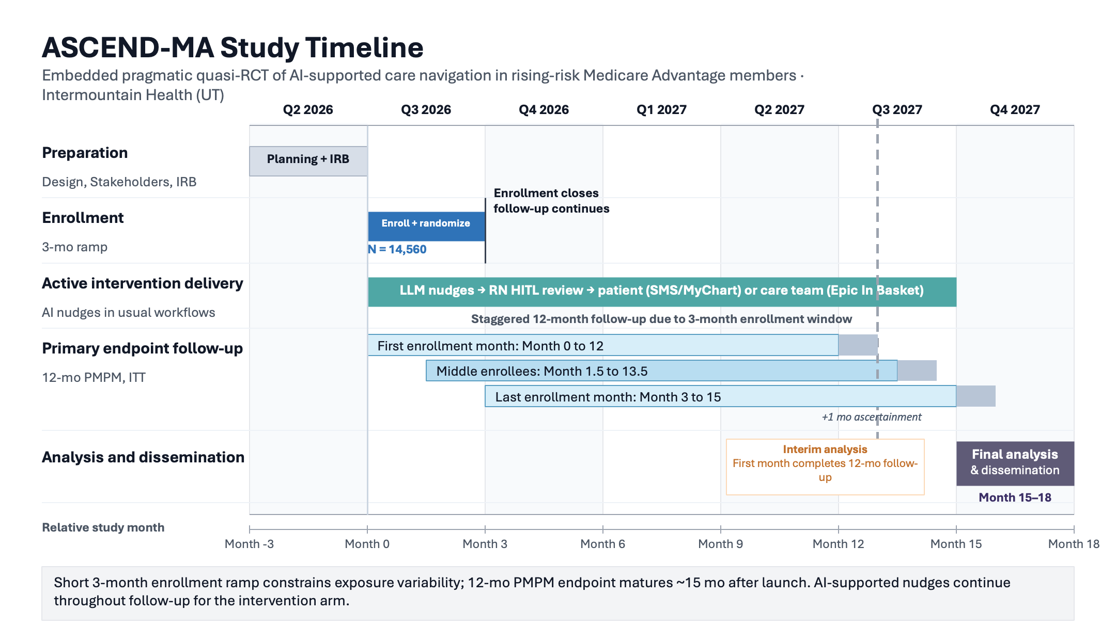
PROTOCOL DESIGN · ASCEND-MA
Trial design at a glance
EXCLUSION CRITERIA
In high-risk CM at index, hospice/EOL, or insufficient scoring history.
QUASI-RANDOMIZATION
MRN parity (1:1) assignment; ITT primary analysis.
PRIMARY OUTCOME
12-mo medical spend
SECONDARY (e.g. PULMONARY)
COPD deterioration
ANALYSIS
ITT vs usual care
Notes:
Purpose: Define prognostic enrichment cleanly.
Key line: Enrichment does not require predicting who responds.
Transition: Critical care trials especially need signal.
Source anchors: Current trial enrichment slide; Kent/prognostic enrichment framing.

Slide 25
ASCEND-MA | WHY EVALUATE NOW
Adoption is coming either way — design now to learn whether it helps
1
Adoption is happening
2
Narrow design window
3
A cautionary precedent
AI tools are spreading across the organization for many reasons, and will expand as models improve.
Moving early lets us build causal-inference design in before adoption is locked in everywhere.
“Hotspotting” looked transformative — until the RCT showed regression to the mean. Enthusiasm is not evidence.
Design the evaluation now and we learn which AI workflows truly help and which should be discouraged or de-adopted.
Cautionary precedent: Camden Coalition hotspotting RCT (Finkelstein et al., NEJM 2020).

Slide 26
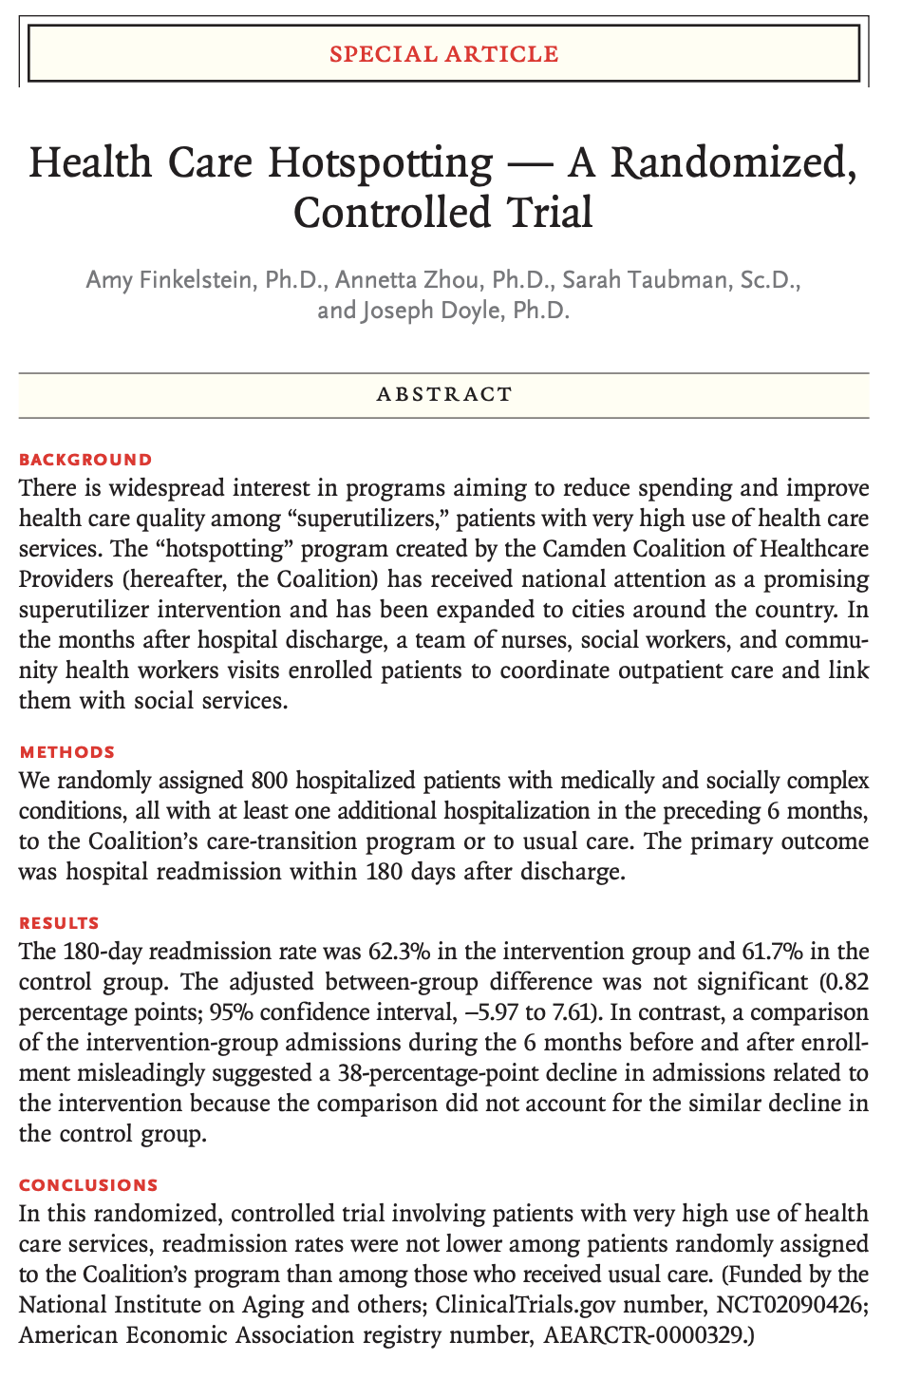
ASCEND-MA | CAUTIONARY PRECEDENT
Hotspotting looked transformative — until it was randomized
THE EXCITEMENT
Intensive care management for super-utilizers showed steep drops in admissions and cost in before-after data.
vs
THE CONTROLLED REALITY
The Camden Coalition RCT found no reduction in 180-day readmissions versus usual care.
Why it failed: patients enter at a peak and many improve anyway… without a control arm, regression to the mean looks like impact.
Source: Finkelstein et al., Health Care Hotspotting — A Randomized, Controlled Trial. N Engl J Med 2020;382:152-162.

Slide 27
AIM-HIGH: Intermountain-SelectHealth
Inpatient-Outpatient Transition for Patients with Hypercapnic Respiratory Failure
AIM-HIGH study team: Brian Locke, David Hedges, Rylan Fowers, Nick Green, Samuel Brown
K23:
Aim 1: Develop and temporally validate automated discharge-risk estimates Aim 2: Compare early EHR, discharge EHR, and claims-augmented predictor sets Aim 3: Test whether target choice changes capacity-limited triage panels
Notes:
Purpose: Show ASCEND-MA as implementation case study.
Key line: The outcome is not AUC; the outcome is operational, clinical, and economic impact.

Slide 28
RATIONALE | HYPERCAPNIC RF TRANSITION
Hypercapnic respiratory failure is high-burden — and these patients are under-evaluated
~1 in 3
~10×
readmitted within 30 days (national)
age-expected mortality (national)
COST BURDEN · PLAN-PAID PER-MEMBER-PER-MONTH (n=5,624, first hypercap RF hospitalization, 2016–2024)
Early baseline
Pre-index 3 mo
Index month
Post-index 3 mo
$3,571/mo
$6,311/mo
$50,084
$6,121/mo
months −12 to −4
+77% vs baseline
≈14× baseline · 84% inpatient
+71% vs baseline
Locke et al., ATS 2026 — SelectHealth/Intermountain cohort, 2016–2024; nominal insurer-paid claims.
Cause Seldom Investigated in Utah
31% PFTs, 21% Sleep study 5y before; 15% PFTs, 10% Sleep study 1y after.
Locke et al., ATS 2025 — Utah All Payor Claims Data, 2016–2024
Notes:
Purpose: Preview K23 without turning this section into a grant pitch.
Key line: HRF can be defined physiologically, but transition care needs a routing class.
Transition: Recap the Label answer, then move to risk-based action.
Source anchors: Locke K23 Specific Aims; prior deck framing.

Slide 29
RISK TARGETING | HIGH-RISK, UNDER-MANAGED
Identifiers of high-risk, under-managed patients
WILSON ET AL.
MERDAD ET AL.
PROPOSED
1 Risk signal
2 Context
3 High-risk phenotype
Wilson: PaCO₂ >50 with normal pH was high risk — 44% died over median 592 days; 44% had ≥2 admissions in 1 year.
ICD-coded cases and those with evidence of compensation more often had respiratory chief complaints in MIMIC-IV.
Both point to a primary respiratory problem needing chronic management.
Candidate high-risk signal:
High HCO₃
PCO₂ above borderline
No recent PFT / sleep / NIV review
Risk rose with higher PCO₂ (adj. HR 1.09 per 5 mmHg).
ML OPTIMIZATION
Quantify strength of predictors, find best workable set
Sources: Wilson et al., Ann Am Thorac Soc 2021; Merdad et al., manuscript draft. Phenotype proposed; validation needed.
Notes:
Purpose: Anchor the K23 in a clinical transition gap.
Key line: HRF transition care is the pulmonary application of reference-class and attention-routing logic.
Transition: Show the three-aim sequence.
Source anchors: Locke K23 Specific Aims.
Required guardrail: HRF transition care is the pulmonary/critical care application of reference-class and attention-routing logic.

Slide 30
APPLY | K23 ROADMAP
Transition-care evidence proposal for Hypercap RF
Aim 1
Aim 2
Aim 3
Measure variation Labeling, testing, equipment/med review, referral, follow-up across IH.
Validate at-discharge risk model for repeat utilization, overall cost, care-burden
Test feasibility of Navigator assessment for prespecified high-risk patients
K23 products: train a health-services research expert in chronic respiratory failure care transitions, as well as planning data for effectiveness trial of risk-targeted care navigation.
Notes:
Purpose: Make the grant sequence legible.
Key line: Measure current care, validate risk infrastructure, then test feasibility before R01.
Transition: Clarify Aim 2 is not deployment.
Source anchors: Locke K23 Research Strategy.
Required guardrails: Aim 2 validates risk infrastructure, not a deployed tool. Aim 3 enrollment is criteria-based and independent of Aim 2 model performance.

Slide 31
AIM 2 | RISK INFRASTRUCTURE
Aim 2 builds the risk model for trial design
Refines the earlier proposed criteria by selecting features and optimizing prediction in SelectHealth insured patients, with transportability assessment to Utah All Payer Claims Data
Enrich the cohort
Estimate effects efficiently
Size the workflow
Raise expected event yield: readmission, Hypercap RF acute care, or death after discharge.
Estimate weekly review lists, site volume, and navigator / RT capacity needs.
Prespecify risk strata to balance arms and sharpen effect estimates.
→
→
Notes:
Purpose: Guard against overclaiming model deployment in the K23.
Key line: Aim 2 validates research-ready risk infrastructure; it is not a clinical deployment tool.
Transition: Clarify Aim 3 is feasibility, not efficacy.
Source anchors: Locke K23 Specific Aims / Research Strategy.
Required guardrail: Aim 2 validates risk infrastructure, not a deployed tool.
This one seems a little too much like the prior one in terms of layout.

Slide 32
AIM 2 | PREDICTION DESIGN
Discharge-time risk model
Entry: ABG PaCO₂ >45, VBG PCO₂ >50, or ICD Hypercap RF codes → discharge = time zero (pre-routing)
PREDICTION TARGETS
Primary
Utilization
Cost
Clinical failure: death or unplanned readmission
Acute-care use
1-year postdischarge cost
PREDICTOR SETS
Set 1 · Early structured EHR
Set 2 · Discharge-available EHR
Set 3 · Claims + finalized discharge
Recognition-stage risk
Primary scalable model
Approximate upper bound
Model: LASSO / elastic-net Cox · calibrated hazard at 30 / 90 / 365 days · temporal test set 2023–2024
Notes:
Purpose: Guard against overclaiming model deployment in the K23.
Key line: Aim 2 validates research-ready risk infrastructure; it is not a clinical deployment tool.
Transition: Clarify Aim 3 is feasibility, not efficacy.
Source anchors: Locke K23 Specific Aims / Research Strategy.
Required guardrail: Aim 2 validates risk infrastructure, not a deployed tool.

Slide 33
AIM 3 | FEASIBILITY TRIAL
Aim 3 tests whether structured assessment is feasible in high-risk HRF transitions
Prespecified high-risk group
Navigator assessment
Feasibility readouts
Hypercap RF diagnosis code + no prior PFT/sleep study + enrichment criteria
care gaps, etiology clues, barriers, medications, equipment, follow-up needs
reach, fidelity, acceptability, burden, barriers, 90-day indicated testing
→
→
Embedded randomized feasibility trial: ~40 patients, 1-3 sites
Estimates workflow requirements (not clinical outcomes), setting the stage for a characterization study (R03) or effectiveness trial (R01).
Notes:
Purpose: Keep Aim 3 as feasibility rather than a full grant pitch.
Key line: Aim 3 tests whether a pathway can reliably route patients to indicated care.
Transition: Return to the four answers and close.
Source anchors: Locke K23 Specific Aims / Reapplication.
Required guardrails: Aim 3 enrollment is criteria-based and independent of Aim 2 model performance. Aim 3 is feasibility, not efficacy.

Slide 34
TRIAL APPRAISAL | PREDICTION MODELS
Prediction models help interpret trials across design, estimates, and application
DESIGN
ESTIMATE
APPLY
Enrich the trial population
Improve effect-size estimation
Personalize interpretation
Target patients most likely to have events or benefit.
Reduce noise and increase precision around treatment effects.
Translate average trial effects to individual patients.

Slide 35
TRIAL DESIGN
Binary-endpoint trials usually cannot detect effects that would still change care
When plausible benefits are small, trial design must recover information through enrichment, better endpoints, or both.
1 Mortality signal is narrow
2 Small effects need large trials
3 Recover information by design
No mortality contrast
Illustrative: 50% mortality, 80% power.
Risk enrichment
Would live either way
Absolute effect
Approx. N
Enough baseline events
Would die either way
10% ARR
~800
Cleaner case definition
5% ARR
~3,100
Less heterogeneity
Outcome changes because of assignment
2.5% ARR
~12,500
Informative outcomes
1% ARR
~78,000
Trajectory (state-by-day)
The assignment-sensitive group is the signal.
Adjustment
Worthwhile effects can be smaller.
Remove noise
Better prediction concentrates measurement where the outcome is plausible, actionable, and learnable.
Notes:
Purpose: Motivate enrichment and adjustment in PCCM trials.
Key line: When outcomes are noisy, better prediction can improve design before predicting response.
Transition: Now show adjustment as the Estimate job.
Source anchors: Critical care trial design; current slide 42.

Slide 36
ENRICH + ESTIMATE | RESIDUAL VARIATION
Baseline risk helps twice: enrich first, adjust after randomization
BEFORE RANDOMIZATION
AFTER RANDOMIZATION
Enrichment: choose who enters
Adjustment: estimate precisely
Enough baseline risk for outcome capture
Prespecify prognostic baseline covariates
Higher event yield and feasible operations
Explain predictable outcome variation
Avoid broad cohorts with uninformative outcomes
Narrow intervals without changing randomization
Goal: more signal
Goal: less noise / residual variation
Source: Morris et al., Trials 2022 — prognostic covariate adjustment can improve precision.
Notes:
Purpose: Summarize the trial design argument.
Key line: Enrichment chooses who enters; adjustment estimates more precisely after randomization.
Transition: Apply the full logic to the K23 HRF program.
Source anchors: Current slide 45; K23 Aim 2 future-use framing.

Slide 37
ESTIMATE
Adjustment removes predictable risk
Randomization preserves the contrast; prognostic covariates explain variation that would otherwise blur the treatment signal.
A decomposition to teach before the regression model
Outcome
=
treatment signal
+
baseline risk (predicted)
+
residual variation
1
Keeps randomization
2
Predict outcome
3
Compare residuals
Treatment assignment remains independent of baseline risk.
Use only information known before treatment to estimate predictable risk.
Smaller residual variation means a smaller SE for the average effect.
Source concept: prognostic covariate adjustment in randomized trials; Morris et al., Trials 2022.
Notes:
Purpose: Introduce prognostic adjustment as precision infrastructure.
Key line: This is precision adjustment in an RCT, not confounding adjustment.
Transition: Quantify the precision payoff.
Source anchors: Senn 2015; trial covariate adjustment literature.
Teaching sequence: intuition, then formula, then numbers. Adjustment is not personalization; it improves estimation of the average randomized effect.

Slide 38
ESTIMATE | R² TO SAMPLE SIZE
Prediction R² is a sample-size dividend
If covariates explain outcome variation, residual variance shrinks and the same precision needs fewer participants.
R²
N needed if N=1,000
N saved
Rule of thumb
0.05
950
50
1.05×
n_adj ≈ n_unadj × (1 − R²)
0.10
900
100
1.11×
SE multiplier ≈ √(1 − R²) Same-n information ≈ 1 / (1 − R²)
0.20
800
200
1.25×
0.30
700
300
1.43×
0.40
600
400
1.67×
R² = prognostic variation explained before randomization
0.50
500
500
2.00×
Approximate gains from prognostic covariate adjustment
Example: R² = 0.20 means ~20% fewer participants for the same precision — or the same trial behaves like ~1.25× as much information.
Most literal for continuous outcomes; use as planning intuition otherwise. Source: Morris et al., Trials 2022.
Notes:
Purpose: Give trialists the mathematical payoff.
Key line: If residual SD falls by 20%, SE falls by 20%.
Transition: Close the trial-methods section by linking enrichment and adjustment.
Source anchors: Senn 2015; efficient estimation framing.

Slide 39
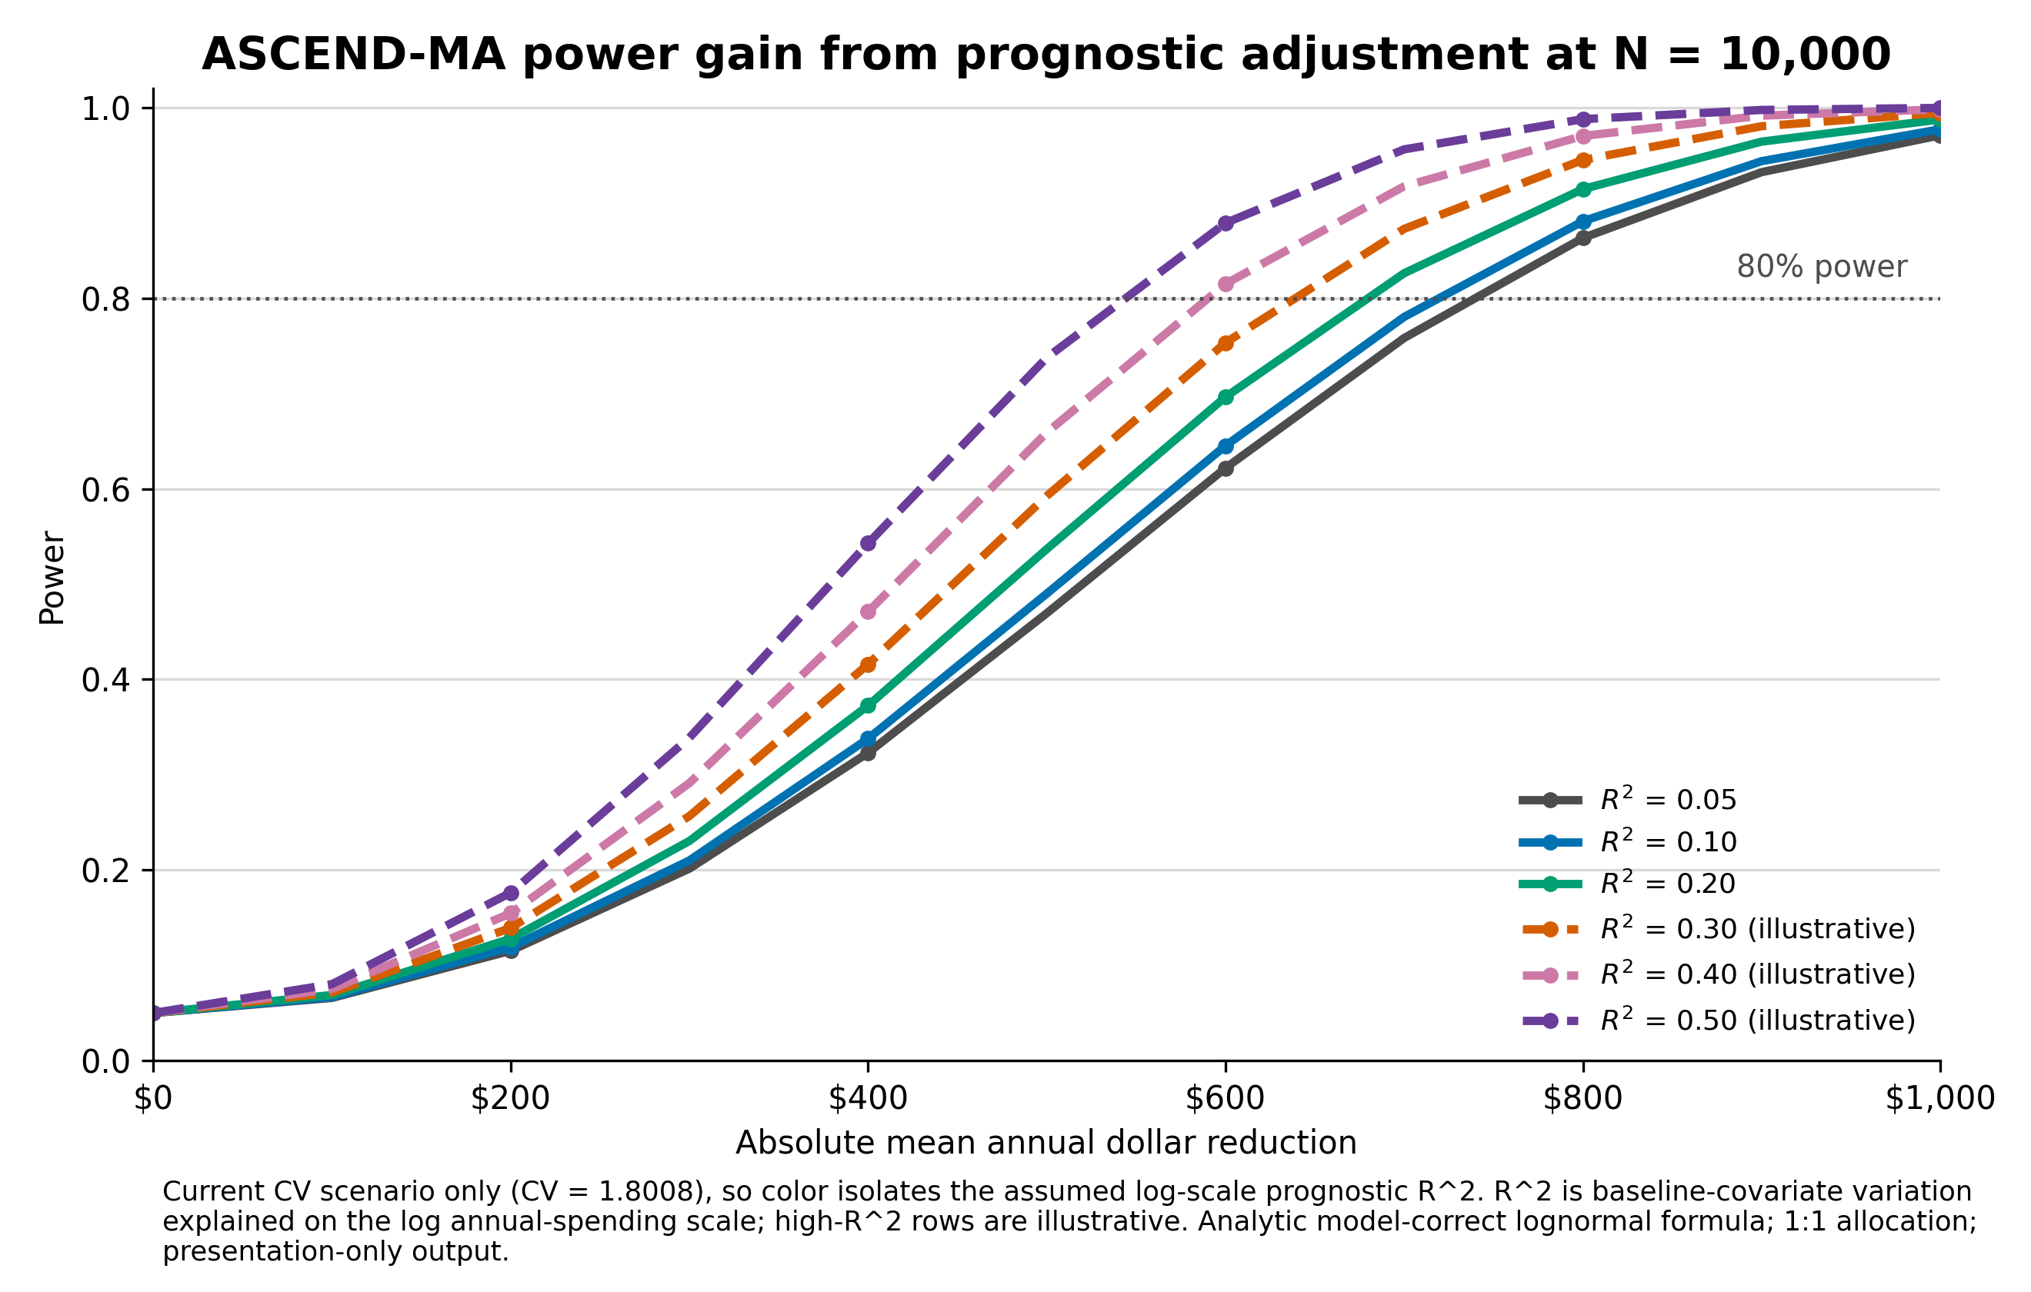
ASCEND-MA risk adjustment sharpens the trial
ENRICH | TRIAL POWER

Slide 40
ACT | APPLYING TRIAL RESULTS TO INDIVIDUALS
A single NNT or ARR hides the distribution of benefit
TRIAL-LEVEL SUMMARY
Lower-risk patients
Low baseline risk → smaller expected absolute benefit
ARR = 2%
Trial average baseline risk
NNT = 50
ARR/NNT applies to this patient
Control 10% → treatment 8%
Higher-risk patients
High baseline risk → larger expected absolute benefit
For individuals, expected benefit on absolute scale matters
Source concept: Harrell 2021, distribution of risk differences (GUSTO-I); Kent 2023, PATH Statement.
Notes:
Purpose: Reframe NNT without dismissing it.
Key line: NNT equals 50 is a population summary, not a patient property.
Transition: Show how baseline risk changes absolute benefit.
Source anchors: Kent 2023; current NNT slide.
[ ]
ARR and NNT conflate baseline risk and treatment effect – not the best way to generalize to other

Slide 41
ACT | RISK-BASED TREATMENT
Relative effects are more stable across risk range
Risk is widely distributed
Few patients sit at the trial average; most differ.
low risk
high risk
Baseline risk
RR
Treatment risk
ARR
NNT
4%
0.50
2%
2%
50
10%
0.50
5%
5%
20
20%
0.50
10%
10%
10
A priori: if treatment blocks a component cause whose frequency scales with risk, efficacy should scale too.
Empiric: when tested, relative effects do stay roughly constant across baseline risk.
Worked example (RR 0.50). Sources: Statistics By Jim 2024; L’Abbé effect-model, Epidemiol Perspect Innov 2009; Doi et al., J Clin Epidemiol 2021.
Notes:
Purpose: Show risk magnification of absolute benefit.
Key line: The same relative effect can produce very different ARR and NNT.
Transition: Benefits and burdens may scale differently.
Source anchors: Kent 2023; Harrell risk-magnification framing.
We should add some evidence that actually, RR’s tend to be more stable than other effect measures.

Slide 42
ACT | RISK MODELING VS EFFECT MODELING
Two versions of “personalized medicine”
Risk modeling
Effect modeling
Who is likely to have the bad outcome?
Who responds differently to treatment?
Risk modeling customizes by pre-randomization prognosis.
Effect modeling customizes by differential response.
Kent 2023; PATH Statement
Notes:
There are two very different ways to personalize treatment. Risk modeling asks who is likely to have the bad outcome. Effect modeling asks whether the treatment itself works differently for different kinds of patients. Both are useful — but they carry different evidence burdens.

Slide 43
ACT | RISK MODELING VS EFFECT MODELING
Risk modeling starts with prognosis
Lower risk
Middle risk
Higher risk
4/100 → 2 prevented
10/100 → 5 prevented
20/100 → 10 prevented
Same treatment, RR 0.5 — events halved in every group.
Absolute benefit (2 → 5 → 10 prevented) grows with baseline risk.
Kent 2023; risk-based treatment framing
Notes:
Risk modeling begins by estimating what would happen without the treatment. If few events were likely, even an effective treatment has little room to help. If many events were likely, the same relative effect translates into much larger absolute benefit. Same treatment, different room for benefit.

Slide 44
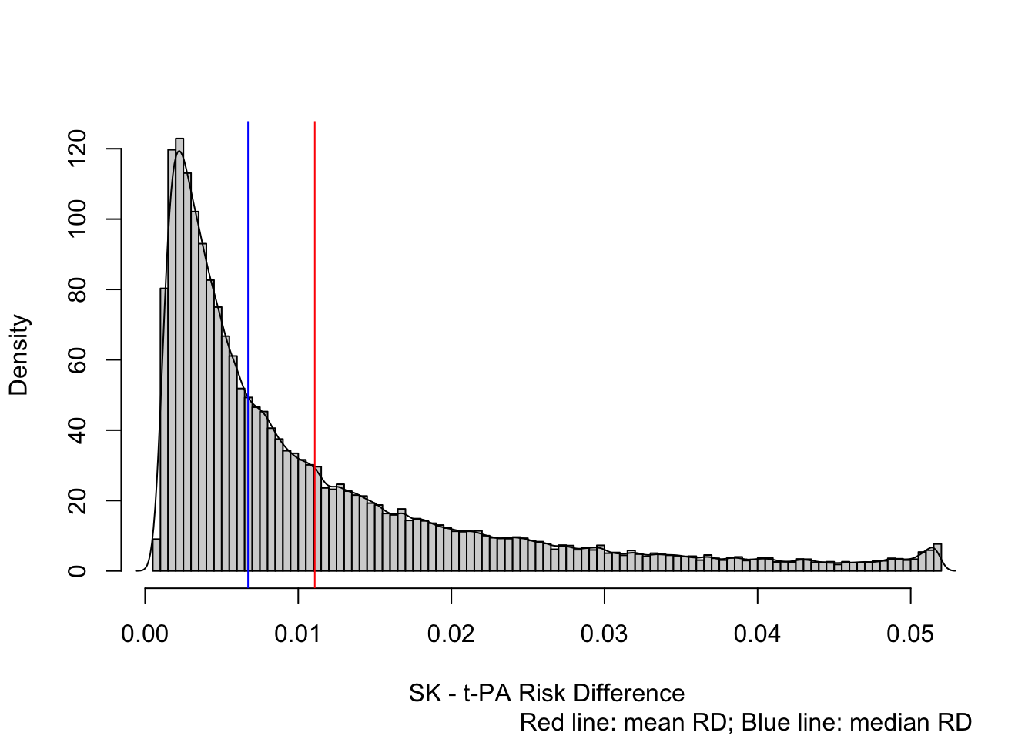
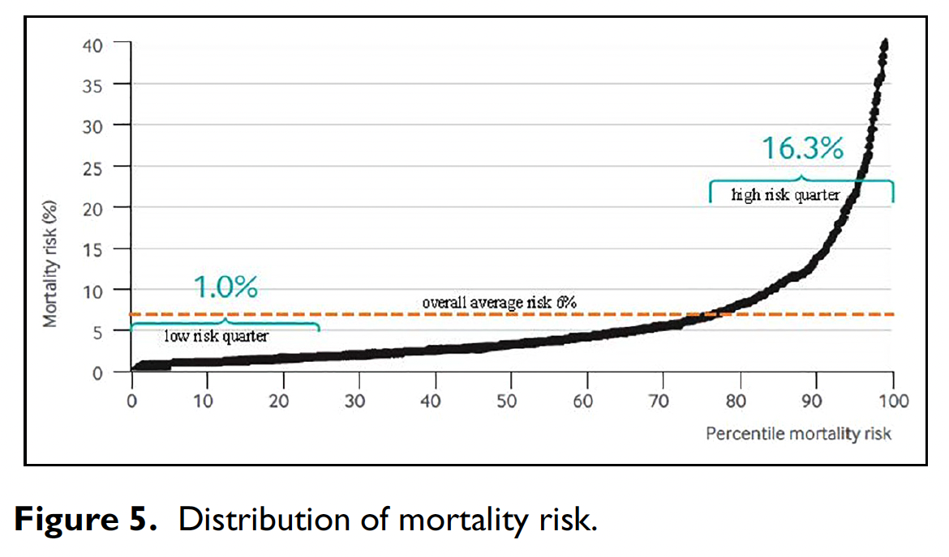
ACT | RISK MODELING VS EFFECT MODELING
The trial average is not the bedside decision
Lower-risk patients
Trial average
NNT = 50
Higher-risk patients
Few events to prevent
Summary estimate
More events to prevent
Kent 2023; PATH Statement
Notes:
NNT is useful and it is not wrong — but it is a group summary, not a property sitting inside the patient in front of us. Risk modeling asks whether this patient is more like the low-risk part of the trial, the average, or the high-risk part. The trial average is one point on a continuum.

Slide 45
ACT | RISK MODELING VS EFFECT MODELING
Risk modeling in practice: stress-ulcer prophylaxis
2024 SCCM/ASHP guideline: treat by bleeding risk, not by being in the ICU.
Has a risk factor → give SUP
No risk factor → withhold
Coagulopathy
Shock
Chronic liver disease
Then: low-dose PPI or H2RA
Ventilation alone is not sufficient risk
Enteral nutrition probably lowers risk
Then: stop SUP once risk factors resolve
Same relative effect, applied by baseline risk: treat the high-risk, spare the low-risk (even patients the original trials enrolled).
MacLaren et al., Crit Care Med 2024;52(8):e421–e430 (SCCM/ASHP).

Slide 46
ACT | RISK MODELING VS EFFECT MODELING
Effect modeling asks a much harder question
Does the treatment work differently for different kinds of patients?
Patient group A
Patient group B
Treatment helps a lot
Treatment helps little — or harms
Sample size explodes
Like a subgroup analysis, you must estimate the effect AND how it differs — two sources of variance. Often 4×+ the sample.
Needs a strong prior
Search enough subgroups and differences appear by chance. Pursue effect modeling only with a real biological reason to expect it.
Kent 2023; Annual Review Biomed Data Science 2025
Notes:
Effect modeling asks a more ambitious causal question. It is not asking who is likely to have the event. It is asking whether the treatment effect itself is larger, smaller, absent, or even harmful in different kinds of patients. Response-first, not prognosis-first.

Slide 47
ACT | RISK MODELING VS EFFECT MODELING
Risk first. Effect models when evidence supports them.
Effect modeling
Does treatment response truly differ?
Risk modeling
What is expected benefit for patients like this?
Average trial result
What happened in the enrolled group?
Risk modeling is the first useful layer of personalization.
Effect modeling carries a higher evidence burden.
Kent 2023; Senn 2015; PATH Statement
Notes:
This is not an argument against effect modeling — it is a sequencing argument. Start with baseline risk because it is easier to validate and often immediately useful. Move to effect modeling when there is enough evidence to believe treatment response truly differs. Risk first; effect models when evidence supports them. From here, risk-first prediction is the practical path — act earlier, label better, enrich trials, estimate more precisely.

Slide 48
CLOSING SUMMARY
Risk-first prediction is the practical path
ACT
ENRICH
Clinical decision support: act when expected benefit exceeds burden
Run trials in the patients who may benefit most
ESTIMATE
PERSONALIZE
Reduce noise: remove predictable variation, preserve randomization
Risk-targeting: tailor by each patient’s baseline risk
Brian W. Locke, MD, MSCI | brian.locke@imail.org
Notes:
Purpose: Close with the thesis and invite discussion.
Key line: Prediction earns its keep when it does work.
Transition: Invite questions.
Source anchors: Full deck synthesis; Wells, ASCEND-MA, K23 sources.

Slide 49
REFERENCES
Key citations
1. Kent DM, Paulus JK, van Klaveren D, et al. The PATH Statement. Ann Intern Med. 2020;172:35-45.
2. Kent DM, van Klaveren D, Paulus JK, et al. PATH Statement: explanation and elaboration. Ann Intern Med. 2020;172:W1-W25.
3. Kent DM, Steyerberg E, van Klaveren D. Personalized evidence-based medicine. BMJ. 2018;363:k4245.
4. Kent DM, Hayward RA. Need for risk stratification. JAMA. 2007;298:1209-1212.
5. Kent DM, Nelson J, Dahabreh IJ, et al. Risk and treatment effect heterogeneity: 32 trials. Int J Epidemiol. 2016;45:2075-2088.
6. van Klaveren D, Balan TA, Steyerberg EW, et al. Interaction models overestimated HTE. J Clin Epidemiol. 2019;114:72-83.
7. Sussman JB, Kent DM, Nelson JP, et al. DPP risk-based treatment reanalysis. BMJ. 2015;350:h454.
8. Fox KA, Poole-Wilson P, Clayton TC, et al. RITA-3 5-year outcomes. Lancet. 2005;366:914-920.
9. Stegenga J. Care and Cure: An Introduction to the Philosophy of Medicine. Univ of Chicago Press; 2018.
10. Doust J, Vandvik PO, Qaseem A, et al. Guidance for modifying disease definitions. JAMA Intern Med. 2017;177:1020-1025.
11. Ranieri VM, et al. Acute respiratory distress syndrome definitions. Am J Respir Crit Care Med. 2022;205:1247-1259.
12. Carrell DS, et al. Phenotyping from clinical text. J Am Med Inform Assoc. 2025.
13. Finkelstein A, Zhou A, Taubman S, Doyle J. Health care hotspotting — a randomized, controlled trial. N Engl J Med. 2020;382:152-162.
Notes:
Purpose: Appendix backup for ML definition.
Key line: Simple models can be powerful when the use case is right.
Transition: Use only if needed during Q&A.
Source anchors: Wells Score / ML article

Slide 50
Thank you
Questions and discussion
WITH THANKS TO
ASCEND-MA trial
Joseph Kamerath, MD
Brian Locke, MD
Haya Khalaf, RN
Kate Minick, PhD
Samuel Brown, MD MSc
AIM-HIGH trial
David Hedges, PhD
Rylan Fowers, PhD
Nick Green
Samuel Brown, MD MSc
K23 mentorship
Samuel Brown, MD MSc
Joseph Finkelstein, MD PhD
Barb Jones, MD MSc
Ben Brintz, PhD
Ithan Peltan, MD MSc
Holly Frost, MD PhD
Brian W. Locke, MD, MSc | brian.locke@imail.org
Notes:
Purpose: Close with the thesis and invite discussion.
Key line: Prediction earns its keep when it does work.
Transition: Invite questions.
Source anchors: Full deck synthesis; Wells, ASCEND-MA, K23 sources.

Slide 51
APPENDIX A1
A1. PATH vocabulary for risk-first personalization
Keep the terms separate: outcome risk, treatment effect, and clinical utility.
HTE = variation in treatment effects on a chosen scale. Clinically important HTE is usually judged on absolute risk difference. CATE/reference-class effect = average effect conditional on covariates, not a directly observed person-level effect.
PATH Statement; Kent et al., Ann Intern Med 2020
APPENDIX
Notes:
Purpose: Appendix backup for ML definition.
Key line: Simple models can be powerful when the use case is right.
Transition: Use only if needed during Q&A.
Source anchors: Wells Score / ML article

Slide 52
APPENDIX A2
A2. Potential-outcomes notation
Individual treatment effect
Reference-class treatment effect
Y(1) − Y(0)
τ(x) = E[Y(1) − Y(0) | X = x]
Only one potential outcome is observed.
= risk under control − risk under treatment
1
Define the reference class
Observed
Missing
Baseline variables/model, before effects.
assigned path
counterfactual
2
Preserve randomization
Randomization holds within the class.
Individual effects remain unobserved—even in an RCT.
3
Report ARR / NNT by risk
Event-rate differences; no counterfactual.
CATE is a randomized average for a risk-defined reference class—not a directly observed patient-level effect.
Source: PATH Statement (Kent et al., Ann Intern Med 2020).
Notes:
Purpose: Define CATE clearly without over-teaching causal inference.
Key line: CATE is causal, not ordinary prediction.
Transition: That is why baseline risk is usually the first useful layer.
Source anchors: AJE 2023 identifiability; AnnRev Biomed Data Sci 2025 HTE learners.

Slide 53
APPENDIX A3
A3. Absolute benefit is the decision scale
Stable relative effects can still create clinically important differences in ARR/NNT.
Report outcome rates, relative effects, and events prevented per 100 patients across risk strata. Show treatment-related harms within each stratum. Decision thresholds depend on treatment burden and patient values.
PATH Statement explanation and elaboration; Figures 1–4
APPENDIX
Notes:
Purpose: Backup for logistic-regression mechanics.
Key line: The main deck does not need to teach the sigmoid.
Transition: Use only if needed during Q&A.
Source anchors: Log-odds notes; current slides 10-11

Slide 54
APPENDIX A4
A4. Why effect models are fragile
Risk modeling
Effect modeling
risk = f(X) — blinded to treatment
risk = f(X + Tx + X×Tx)
Define baseline risk before examining treatment effects; within each stratum, randomization still supports treated-versus-control comparisons.
Estimate which covariates modify the treatment effect—an interaction problem with low power, multiplicity, and false-discovery risk.
baseline risk
if RR = 0.80
NNT
overall effect
N
5%
ARR 1%
100
one balanced
≈4× N
25%
ARR 5%
20
20% subgroup
≈10× N
easy arithmetic on the absolute scale
Interactions multiply tests, sample-size needs, and validation burden.
Start with conditional-on-risk estimates; Treatment×covariate interactions only with strong priors or very large pooled data.
Source: PATH Statement; Kent et al., Ann Intern Med 2020.
Notes:
Purpose: State the main treatment-rule claim.
Key line: Use more risk models before more effect models.
Transition: Now apply risk targeting to scarce attention.
Source anchors: Kent 2023; Senn response-variation caveat.
Risk modeling: apply f(X) without treatment, then compare treated vs control within risk strata. Effect modeling: estimate treatment×covariate interactions. Use effect models cautiously: low power, multiplicity, and overfitting risk

Slide 55
APPENDIX A5
A5. Conditional-on-risk estimates preserve randomization
Risk strata are defined before examining treatment effects.
Use information known before treatment or a prespecified risk model. Within each stratum, randomization still supports treated-versus-control comparisons. This gives rigorous, patient-centered reference-class estimates.
PATH risk-modeling strategy; conditional-on-risk reference classes
APPENDIX
Notes:
Purpose: Backup for ASCEND-MA operational evaluation.
Key line: If review capacity is fixed, evaluate the actionable band.
Transition: Use only if needed during Q&A.
Source anchors: ASCEND-MA protocol

Slide 56
APPENDIX A6
A6. Reporting checklist for PATH-aligned analyses
A risk-first analysis should be readable as a decision analysis.
1. Show the risk distribution. 2. Report discrimination/calibration. 3. Show ARR, RR, and NNT by stratum. 4. Include treatment-related harms. 5. Translate to threshold or decision impact.
PATH consensus guidance on applying and reporting risk models
APPENDIX
Notes:
Purpose: Backup for HTE caution.
Key line: Different p-values do not prove different effects.
Transition: Use only if needed during Q&A.
Source anchors: HTE learners; AJE 2023

